Slide 1

Predictive Analytics for Retail Banking Done by vamsi

Slide 2
RETAIL BANKING ??!
Typical mass-market banking in which individual customers use local branches of larger commercial banks. Services offered include savings and checking accounts, mortgages, personal loans, debit/credit cards. The focus is on the customer.
The main challenges this sector are :
What is the suitable product to recommend to a customer ?
What is the best time to market the product ?
Which is the most effective channel to contact a customer ?

Slide 3
PROBLEM STATEMENT
In this problem, the data is related with direct marketing campaigns of a banking institution. The marketing campaigns were based on phone calls. Often, more than one contact to the same client was required, in order to access if the product (bank term deposit) would be ('yes') or not ('no’) subscribed. The goal is to predict if the client will subscribe a term deposit.

Slide 4
ABOUT DATASET
This is the classic marketing bank dataset uploaded originally in the UCI Machine Learning Repository. The dataset gives you information about a marketing campaign of a financial institution in which you will have to analyse in order to find ways to look for future strategies in order to improve future marketing campaigns for the bank.

Slide 5
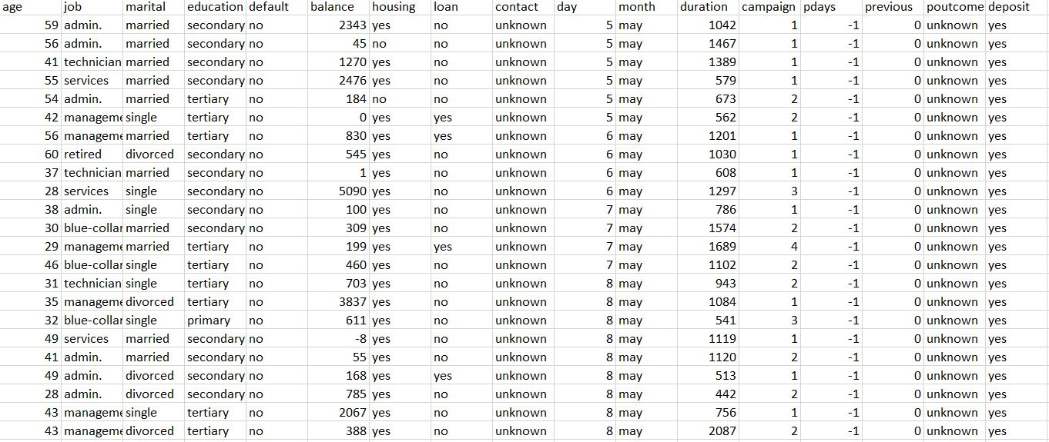

Slide 6
Here are what the columns in the data set represent:
Age : Age of the client- (numeric)
Job : Client’s occupation - (categorical) (admin, blue-collar, entrepreneur, housemaid, management, retired, self employed, services, student, technician, unemployed, unknown)
Marital : Client’s marital status - (categorical) (divorced, married, single, unknown, note: divorced means divorced or widowed)
Education : Client’s education level - (categorical)
Default : Indicates if the client has credit in default - (categorical) (no, yes)
Balance :average yearly balance, in euros (numeric).
Housing : Does the client as a housing loan? - (categorical) (no, yes)
Loan : Does the client as a personal loan? - (categorical) (no, yes)
Contact : Type of communication contact - (categorical) (unknown, cellular, telephone)
Day : Day of last contact with client.
Month : Month of last contact with client - (categorical) (Jan - Dec)

Slide 7
Duration : Duration of last contact with client, in seconds - (numeric) For benchmark purposes only, and not reliable for predictive modelling.
Campaign : number of contacts performed during this campaign and for this client (numeric, includes last contact) - (numeric) (includes last contact)
Pdays : Number of days passed client was last contacted - (numeric) (-1 means client was not previously contacted)
Previous : Number of client contacts performed before this campaign - (numeric)
Poutcome : Previous marketing campaign outcome - (categorical)
Deposit : subscription verified. (output)

Slide 8
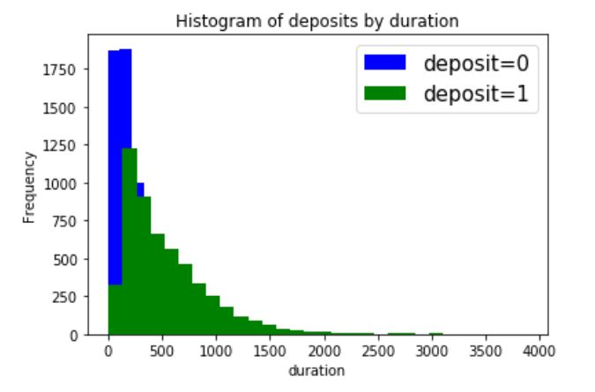
EXPLORATORY DATA ANALYSIS(EDA)

Slide 9
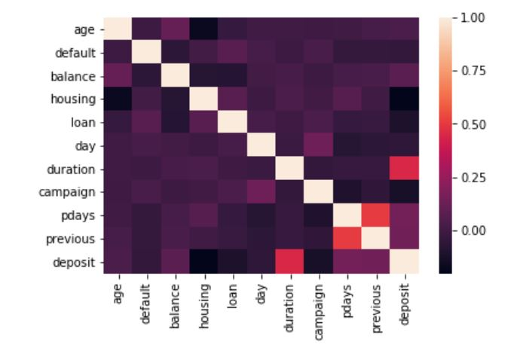
CORRELATION
USING
HEATMAP

Slide 10
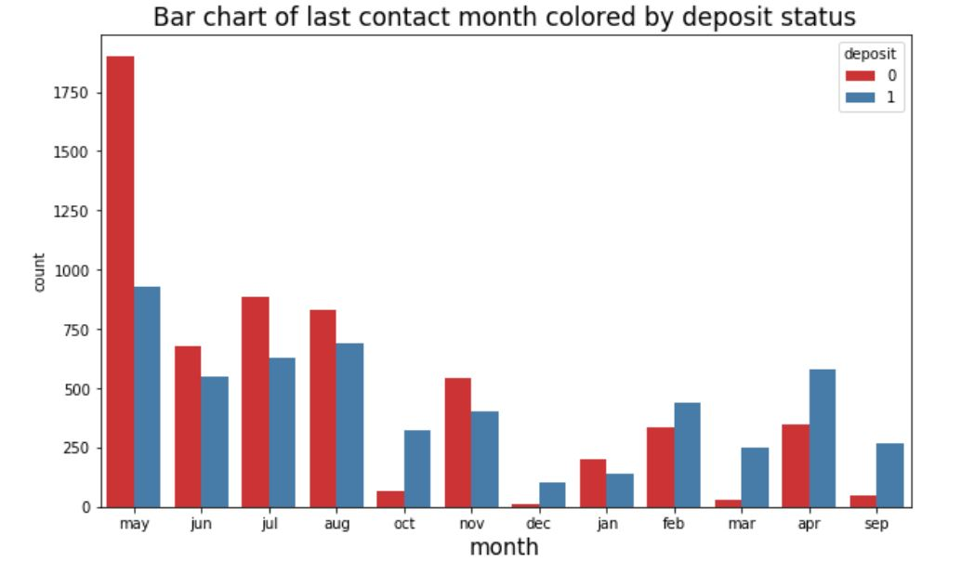

Slide 11
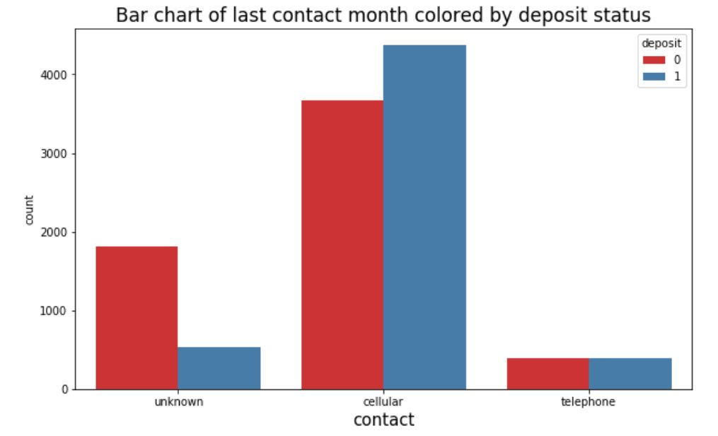

Slide 12
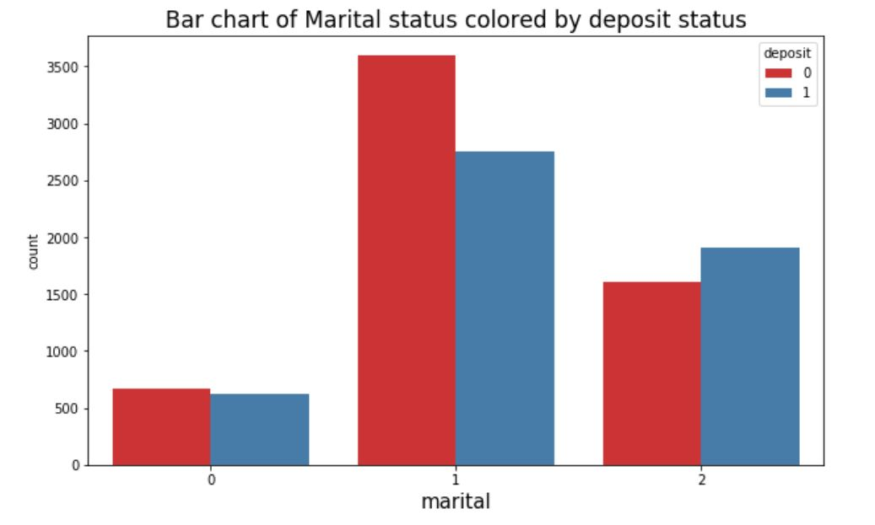
0→divorced
1→married
2→single

Slide 13
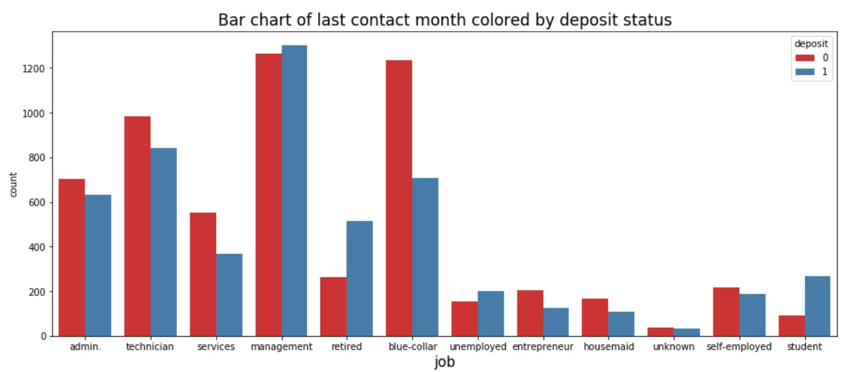

Slide 14
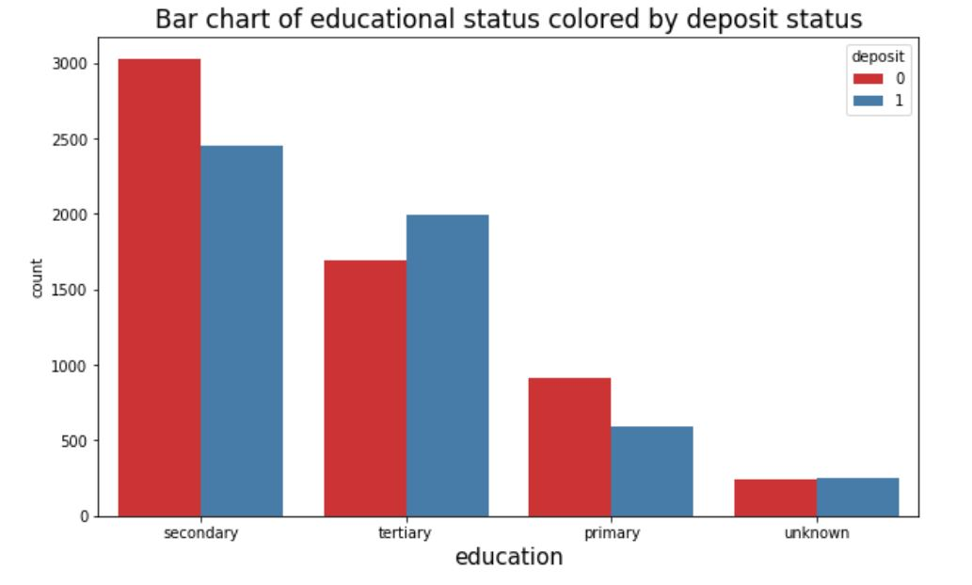

Slide 15
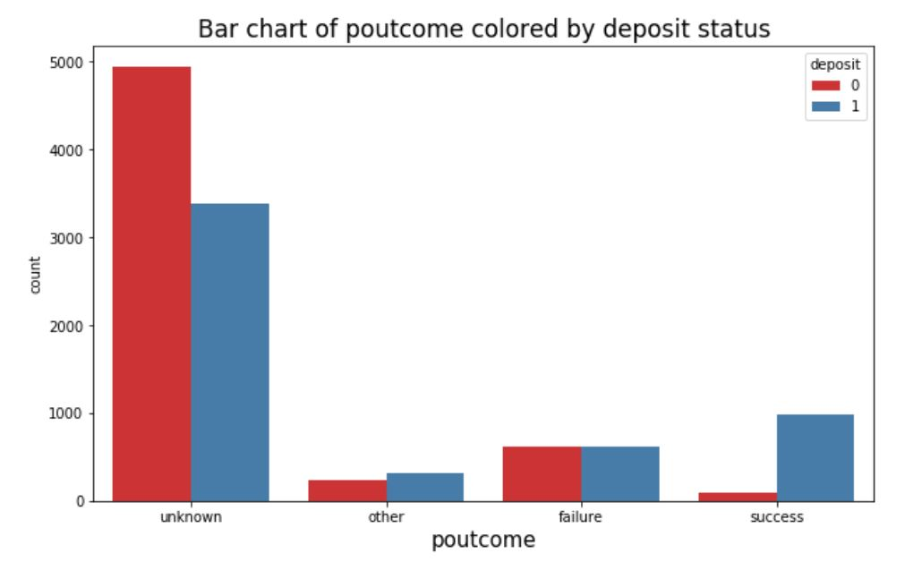

Slide 16
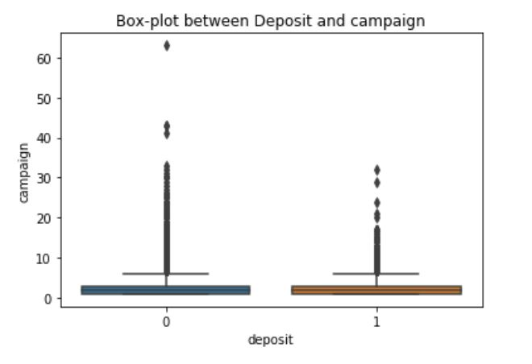
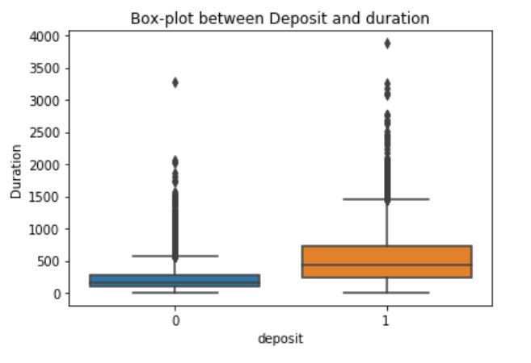

Slide 17
Model Selection

Slide 18

Why Min Max Scaler?
Since the output variable is in 0’s and 1’s form, We need to scale down our feature variables to the range of 0 and 1

Slide 19
TEST SIZE
80-20
*Recommended for banking sector

Slide 20
Accuracies compared …
K-nearest Neighbour: 75.3%
Logistic Regression: 80.9%
Decision Tree: 78.2%
Random Forest Classifier: 78%
Support vector Machine: 53%

Slide 21

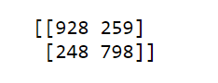



Confusion Matrices..
KNN
Logistic Regression
Decision Tree
Random Forest
SVM

Slide 22
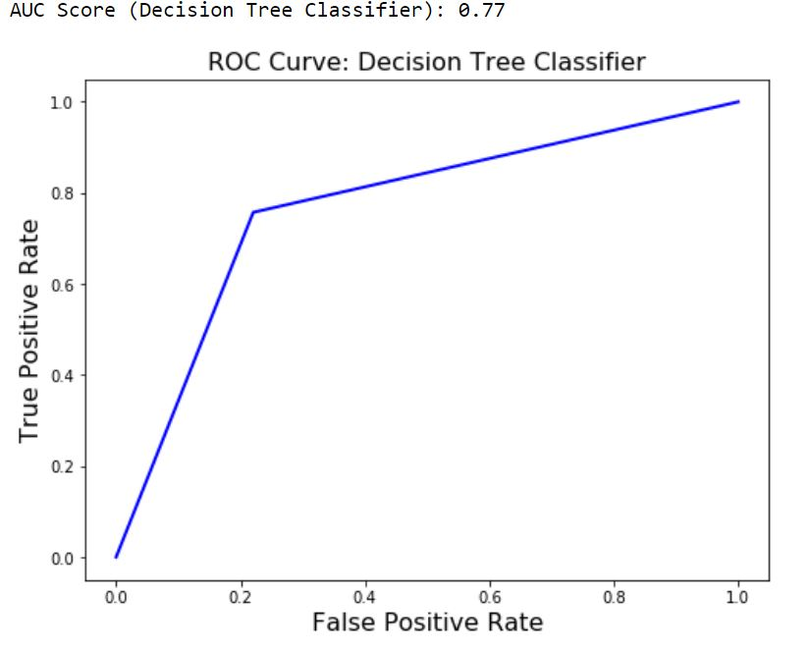
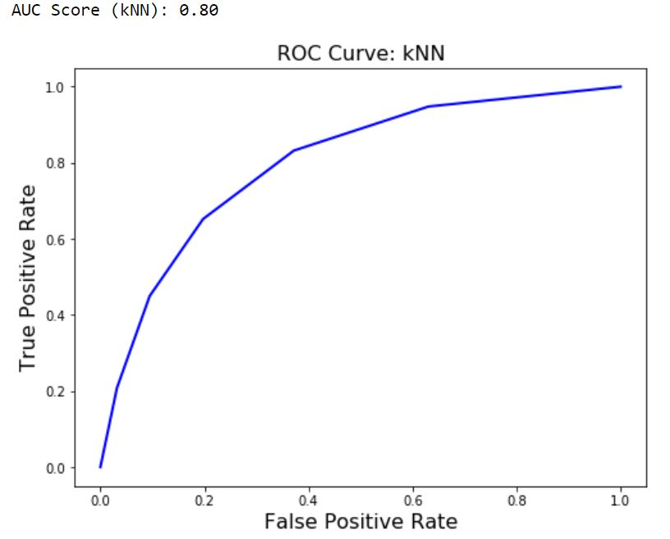
GRAPHS

Slide 23
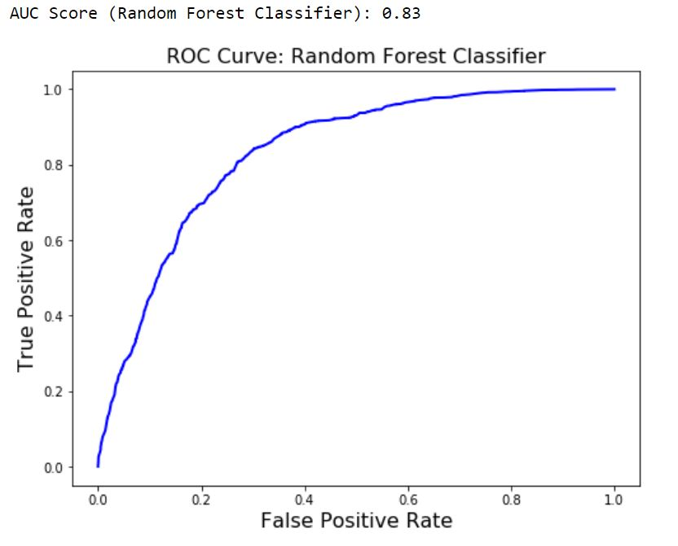
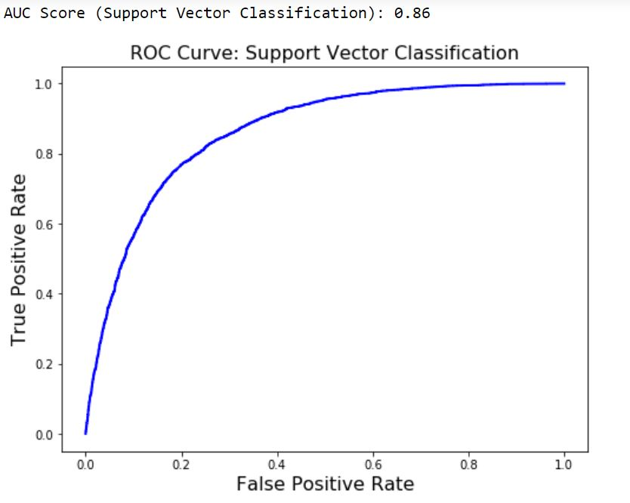
GRAPHS (CONT.)

Slide 24
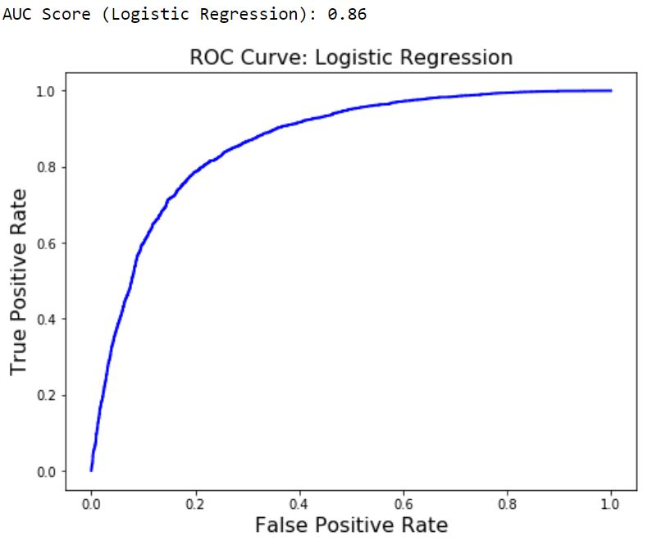
GRAPHS (CONT.)

Slide 25
WE CHOOSE
LOGISTIC REGRESSION
Accuracy = 80.9%

Slide 26
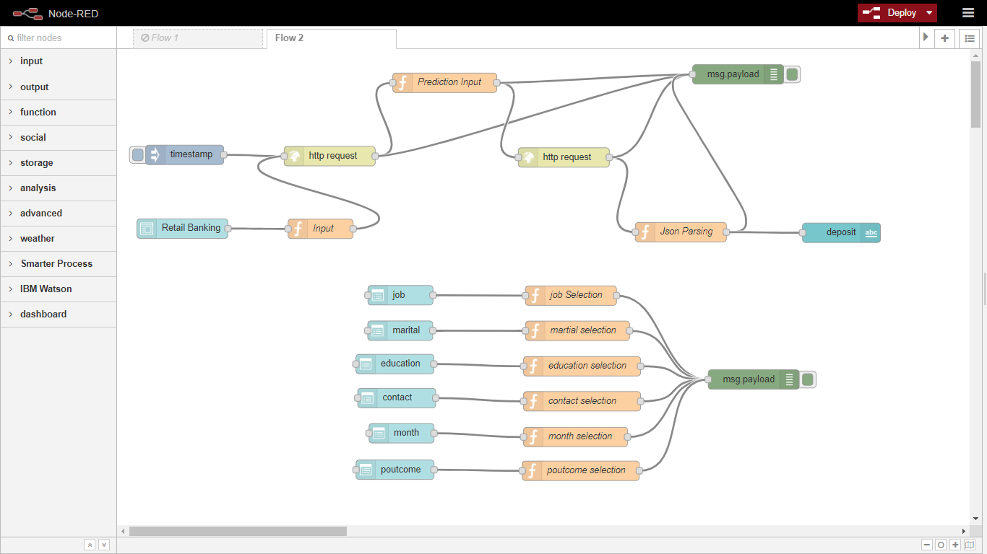

Slide 27
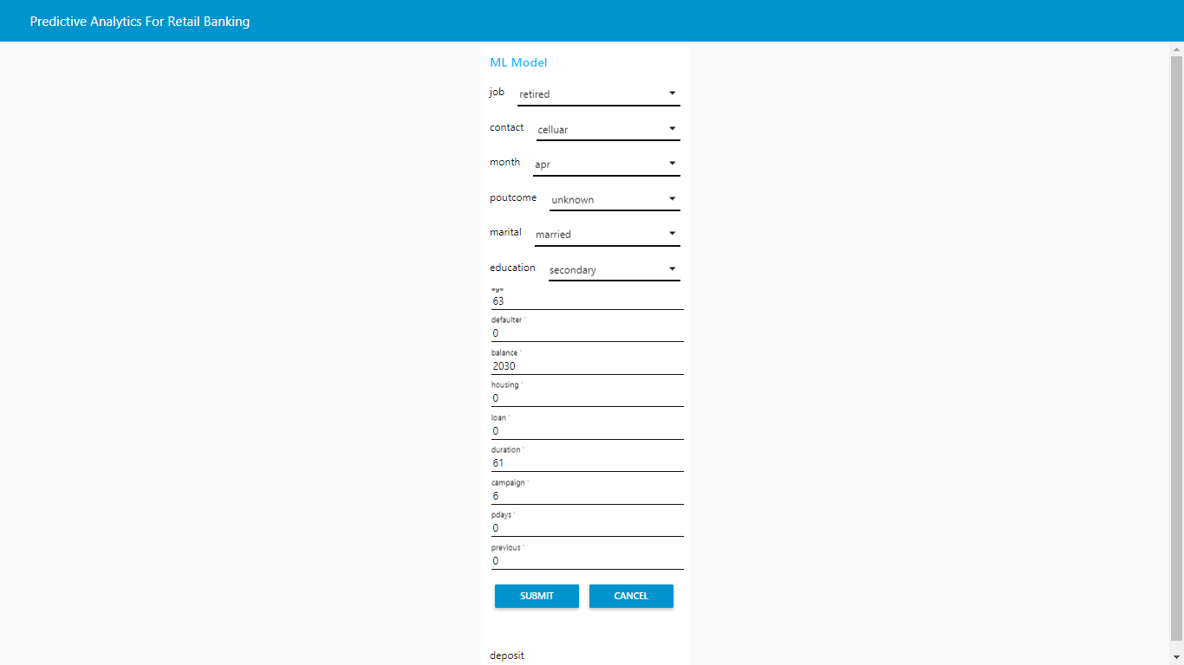

Slide 28
CONCLUSION
Most classification problems in the real world are imbalanced. Also, almost always data sets have missing values. In this post, we covered strategies to deal with both missing values and imbalanced data sets. We also explored different ways of building ensembles in sklearn. Below are some takeaway points:
Sometimes we may be willing to give up some improvement to the model if that would increase the complexity much more than the percentage change in the improvement to the evaluation metrics.
When building ensemble models, try to use good models that are as different as possible to reduce correlation between the base learners. We could’ve enhanced our stacked ensemble model by adding Dense Neural Network and some other kind of base learners as well as adding more layers to the stacked model.
Easy Ensemble usually performs better than any other resampling methods.

